Slide 1
Sponsor Your Healthcare Professional
Area 28 CPC Committee
Summer 2013

Slide 2
Sponsor Your Healthcare Professional
This initiative is meant for the A.A. member to introduce their Healthcare Professional to Alcoholics Anonymous.
Many A.A. members may want to approach their Healthcare Professional but do not always have the information to do so.
It is hoped though this initiative that more Healthcare Professionals will become familiar with A.A. and will pass this information on to people they come in contact who may benefit from what A.A. offers.

Slide 3
Sponsor Your Healthcare Professional
The cover letter on the envelopes should provide the A.A. member with enough information to make an approach to their provider.
Inside the envelopes is a letter from the Area 28 Cooperation with the Professional Committee; enclosures describing what A.A. is and what it isn’t; information on where to get more information; and a copy of the local AA meeting list.
The intent is that a member may simply leave the Healthcare Profession with the envelope and the professional can review the material at their leisure.

Slide 4
Sponsor Your Healthcare Professional
Packets consist of the following:
#10 Business Envelope
Note to AA Member that is attached to envelope and removed prior to handing to Healthcare Professional
Letter to Healthcare Professional
Current Enclosures from AAWS
A.A. At a Glance (F-1)
Information on Alcoholics Anonymous (F-2)
Problems Other Than Alcohol (F-8)
About AA - Newsletter for Professionals (F-13 Spring 1993)
Local AA Meeting List

Slide 5
Sponsor Your Healthcare Professional
Alternative Enclosures For Medical Professionals:
“A.A. as a Resource for the Health Care Professional” (P-23 $.25)
“Problems Other than Alcohol” (F-8) (P-35 $.15)
“The A.A. Member—Medications and Other Drugs” (P-11 $.25)
“Three Talks to Medical Societies by Bill W., Co-founder of A.A.” (P-6 $.45)
Note that the pamphlets that have a prefix of “F-” are free and the ones that start with “P-” have a cost associated which I have noted.
In the interest of costs I suggest using the ones starting with “F-” in the packets and have some of the others beginning with “P-” to hand out to interested medical professionals

Slide 6
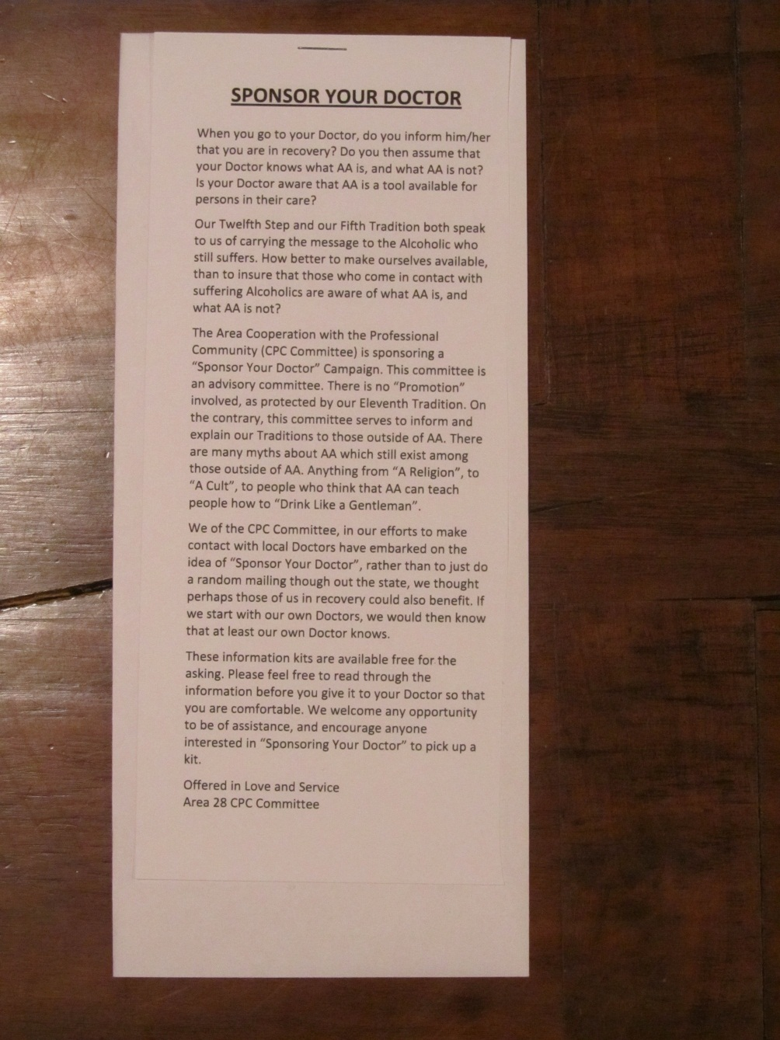
Sponsor Your Healthcare Professional Note to AA Member

Slide 7
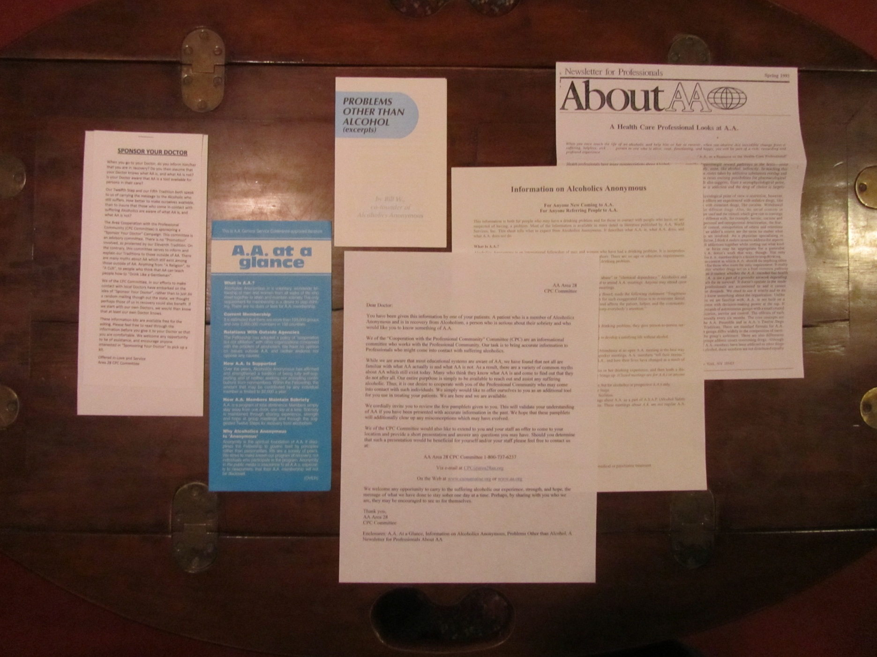
Sponsor Your Healthcare Professional Contents

